Slide 1
Exploring the Impact of Demographics on Rates of Heart Disease:
A Time Series Analysis
Annie Dale & Rebecca Schwarz

Slide 2

Importance
Heart Disease: broad term for variety of cardiovascular diseases
Ex: Strokes, Heart Failure, Coronary Heart Disease, Cardiovascular Disease
Leading cause of death in the US
Caused by genetic and lifestyle factors
Need an understanding of demographic and geographic factors and trends
Major healthcare disparities in minority groups
Regions have different cultures and lifestyles

Slide 3

Project Objectives
Explore patterns in rates of heart disease across demographic groups and geographic regions.
Use Time Series Analysis to predict how rates of heart disease might change across demographic groups overtime.

Slide 4
Summary of Data
5.8 million rows of data set (1.2GB)
Represents: yearly average of the rate of heart disease across demographic groups and geographic regions from the years 1999 to 2019
21 columns
Including: year, state, county, disease, age group, race, sex, data value
Cleaning the Data:
Drop NaN values
Convert data types and units of columns
Create column for geographic region
For Time Series Analysis, need to take averages by year

Slide 5
Trend Exploration
Subset ‘All heart disease’ → Patterns across demographics and regions

Slide 6
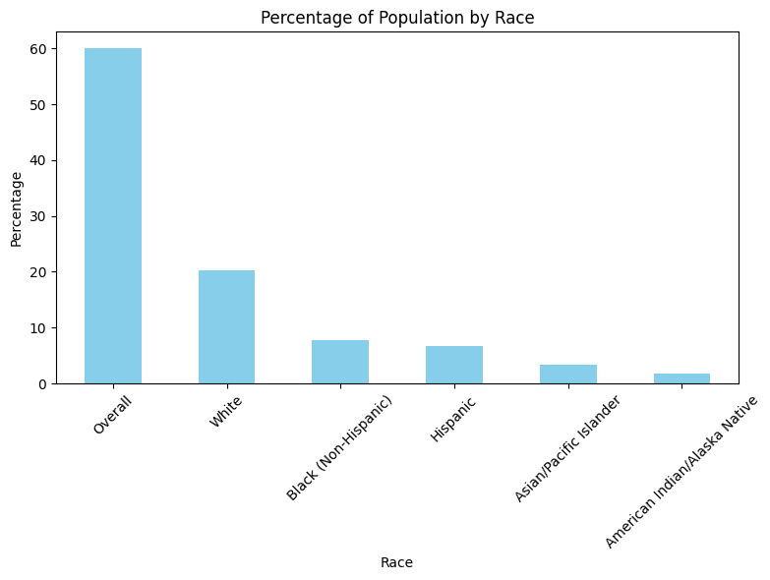
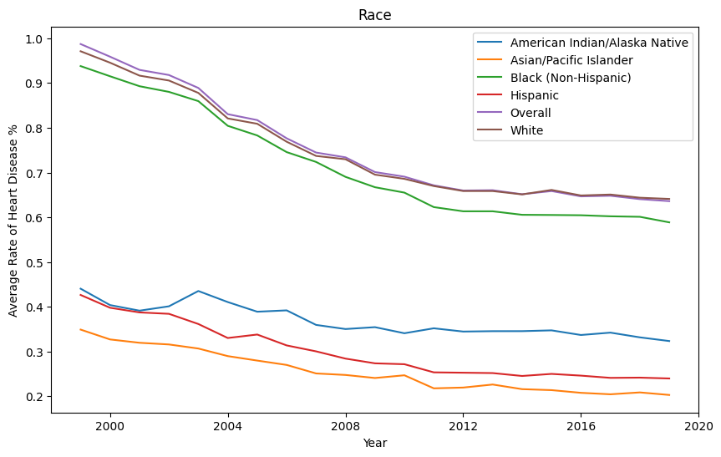
Spread of Race in the data set.
Average rate of heart disease overtime across racial groups.
Trend: Steady decrease in rate of heart disease across all racial groups.

Slide 7
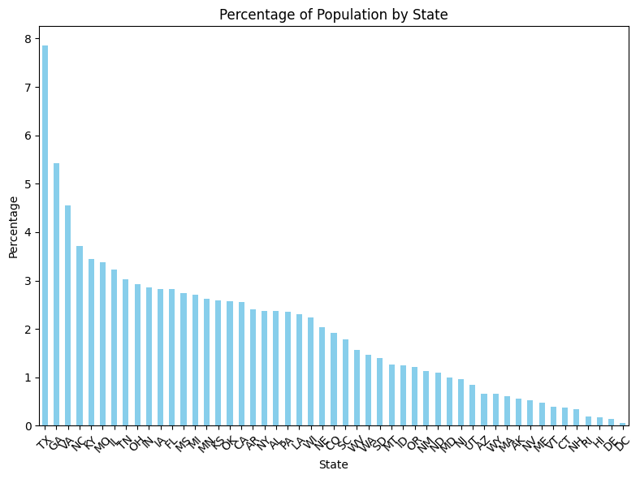
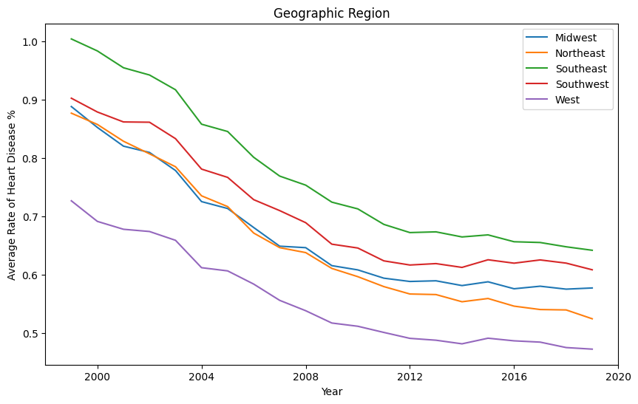
Spread of States in the data set.
Average rate of heart disease overtime across geographic regions.
Trend: Steady decrease in rate of heart disease across all geographic regions.

Slide 8
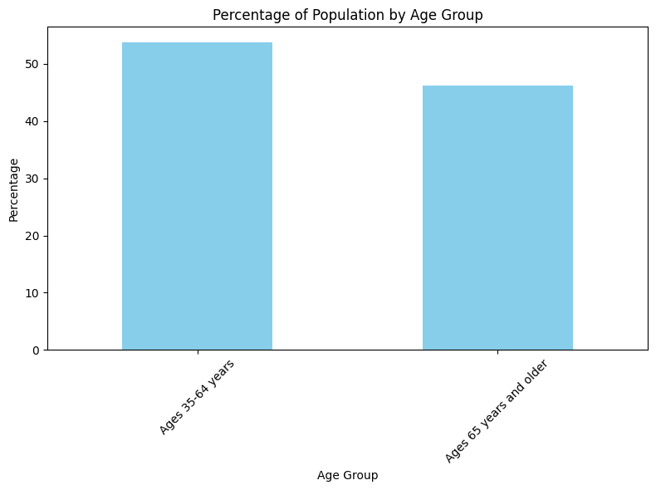
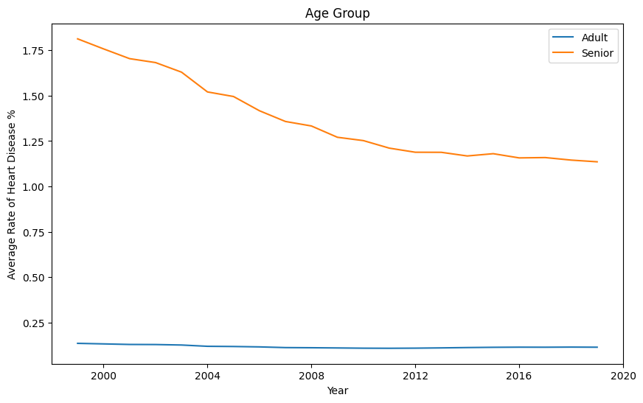
Spread of Age Groups in the data set.
Average rate of heart disease overtime across age groups.
Trend: Rates in Seniors (65 & Older) are much greater than Adults.

Slide 9
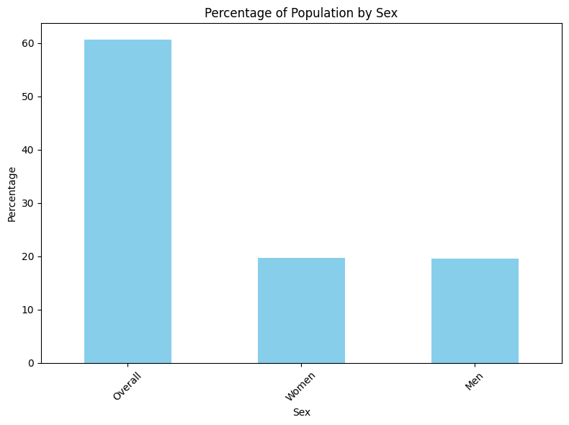
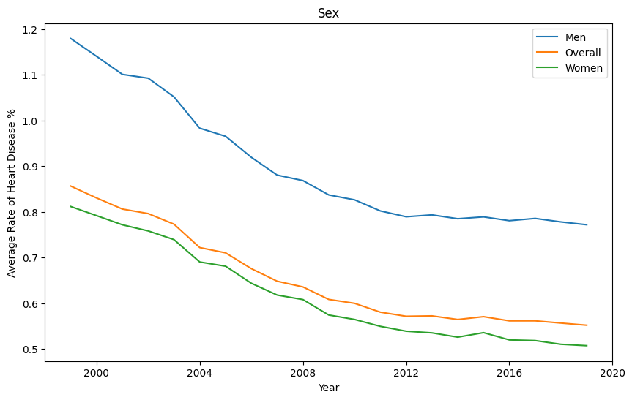
Spread of Sexes in the data set.
Average rate of heart disease overtime across sexes.
Trend: Steady decrease in rate of heart disease across all sexes.

Slide 10
Time Series Analysis
Focuses: Sex, Racial Minority Groups, Regions with Highest Rates

Slide 11
Preparing for Modeling: Polynomial Regression
General Trends
Steady decrease in heart disease rate throughout the years across all demographics
Stationary
Tried ARIMA models on raw data → unsuccessful
Polynomial Regression (next step)
Similar to linear regression
Fits a curved line to the data
Polynomial coefficients minimize squared error
Notes:
We noticed that there is a trend in the data: steady decrease in heart disease rate throughout the years across all demographics. We also noticed the data is pretty stationary. Previously we tried an ARIMA model on the raw data, which was not very successful because the data was too stationary. So we tried a simpler model to represent the trend in the data.
Polynomial regression is similar to linear regression, except it fits a curved line to the data, instead of a straight line. This worked better for our data because of the steady decrease in heart disease rates.

Slide 12
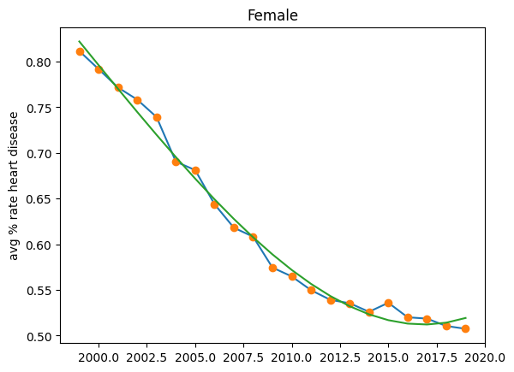
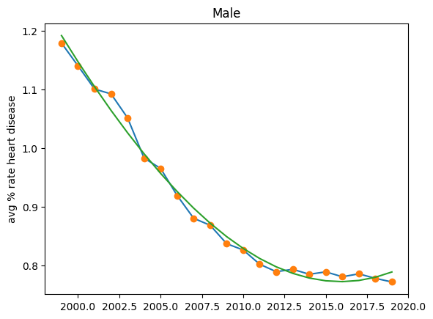
Polynomial Regression
Subset Demographic/Geographic Group
Group by year, plot average rate of heart disease overtime
Fit a cubic polynomial to the data
Demonstrate pattern and trend
R² = 0.99
R² = 0.99

Slide 13
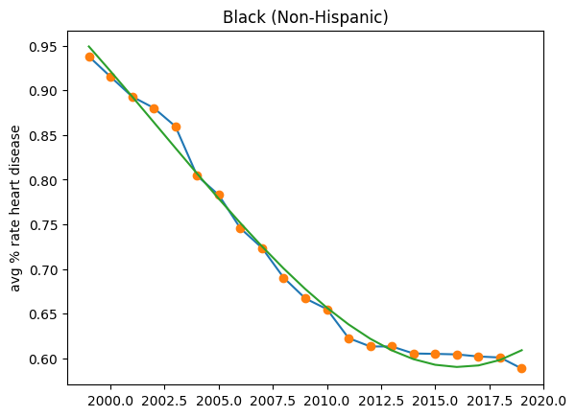
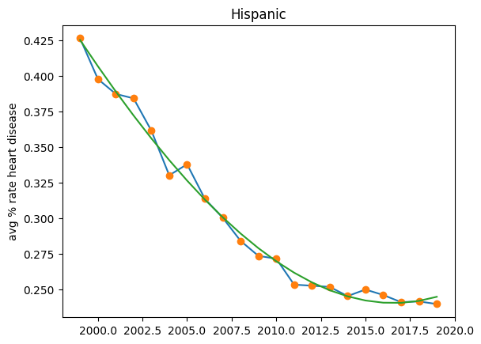
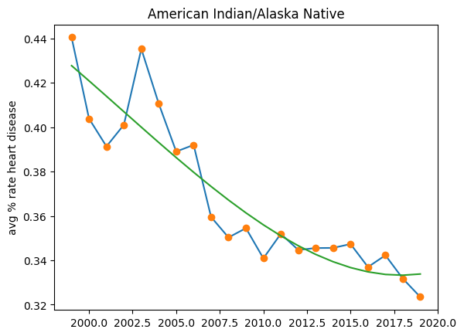
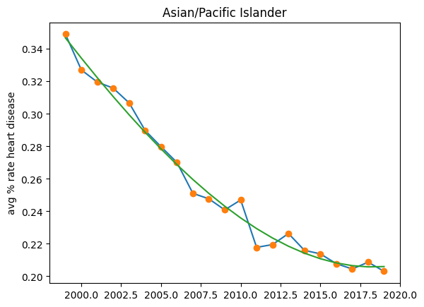
R² = 0.99
R² = 0.99
R² = 0.84
R² = 0.99
Polynomial Regression across minority racial groups.

Slide 14
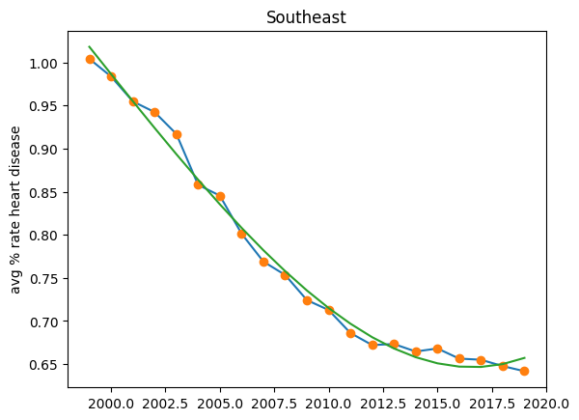
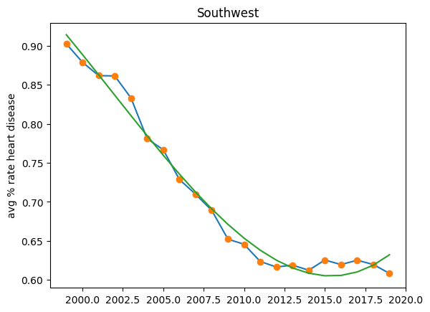
R² = 0.99
R² = 0.98
Polynomial Regression across geographic regions with highest rates of heart disease.

Slide 15
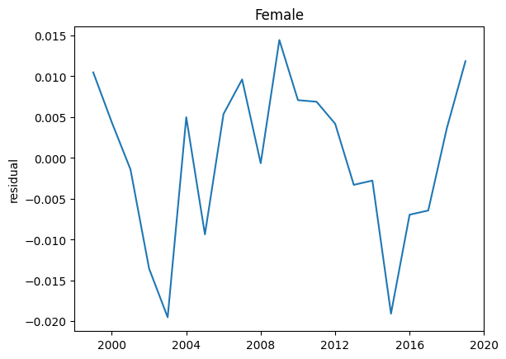
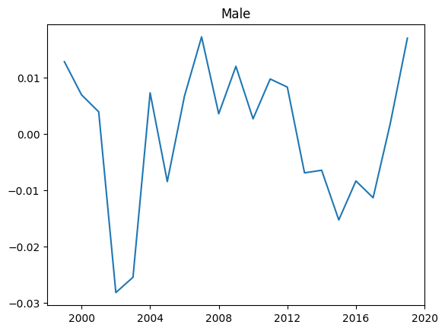
Residuals
Residuals = Original Data - Polynomial Regression
Shows the variation in the data by removed the observed trend
Use to predict how the data will deviate from the observed trend
Creates ‘noise’ in the data that ARIMA models prefer

Slide 16
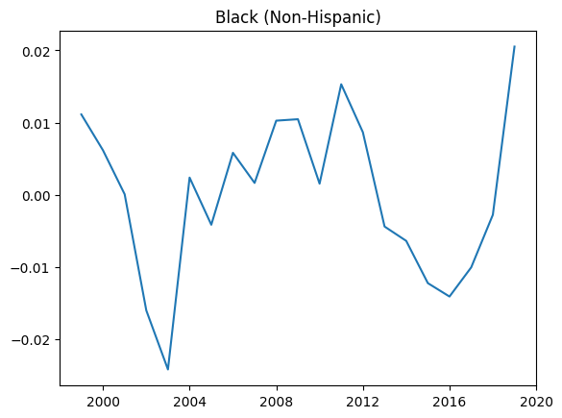
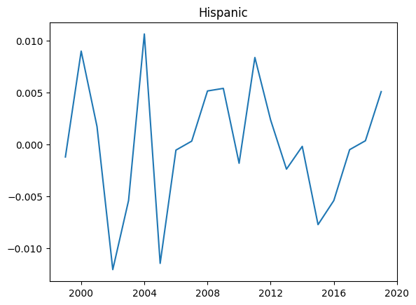
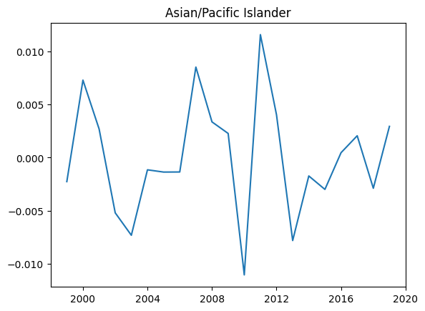
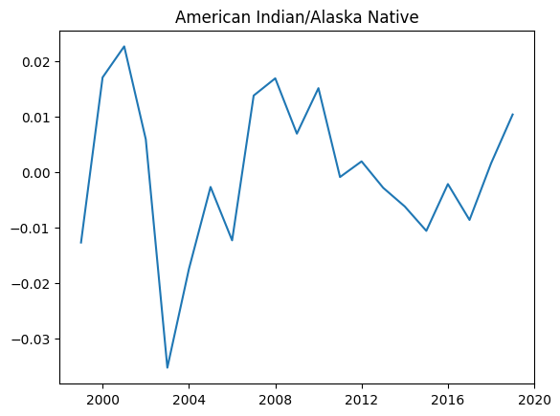
Plotted residuals across minority racial groups.

Slide 17
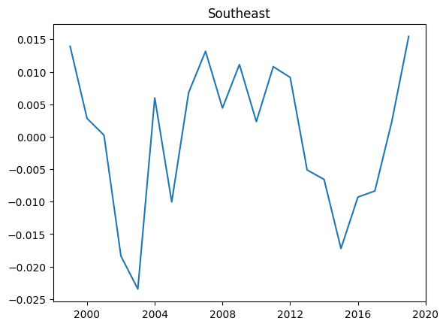
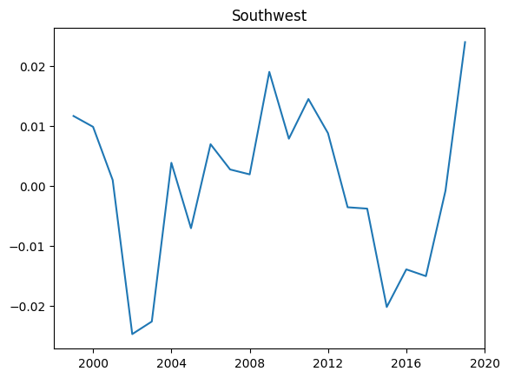
Plotted residuals across geographic regions with highest rates of heart disease.

Slide 18
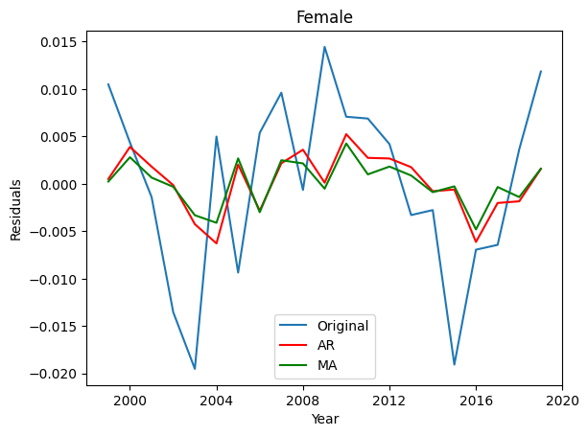
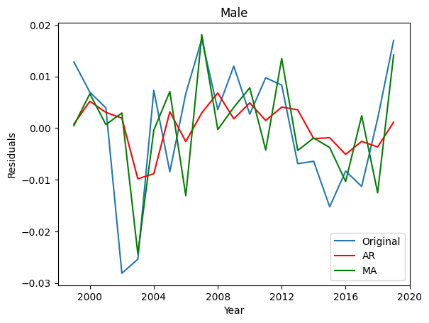
ARMA Modeling with Residuals
Goal: Predict how variation in the data will deviate in the future
Tried Autoregressive with lag order of 1 (influence of the previous value)
Tried Moving Average with lag order of 1 (influence of the previous error)

Slide 19
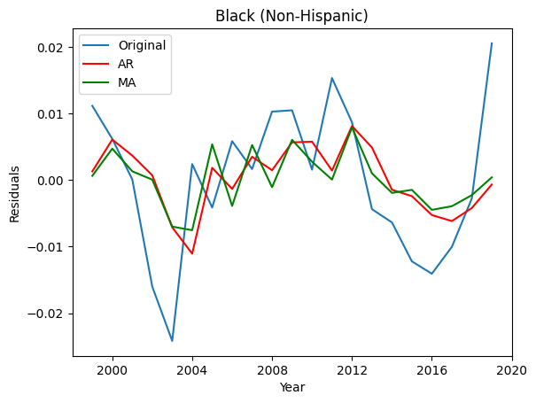
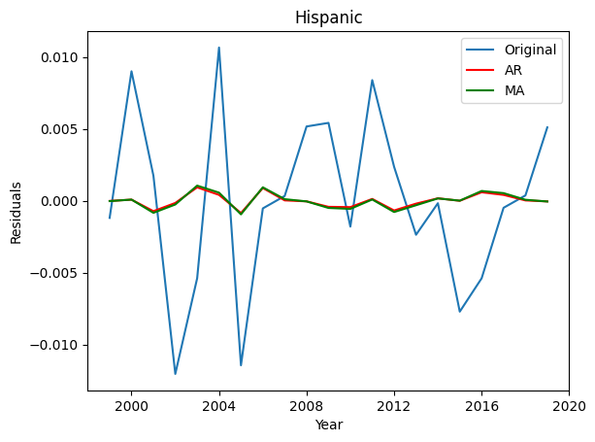
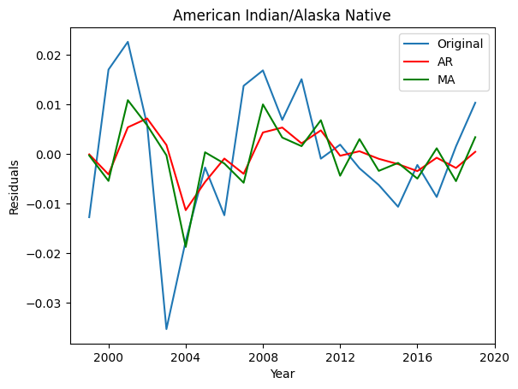
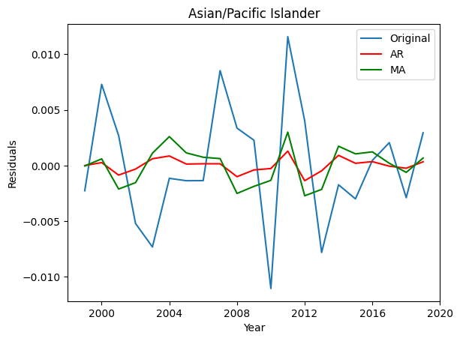
Plotted residuals across minority racial groups.
Plotted residuals, autoregressive predictions, and moving average predictions across minority racial groups.

Slide 20
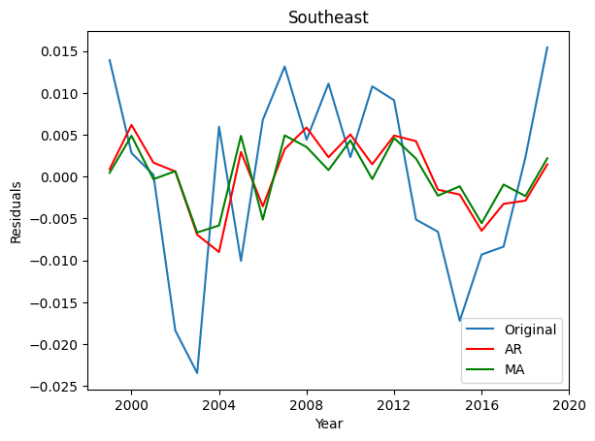
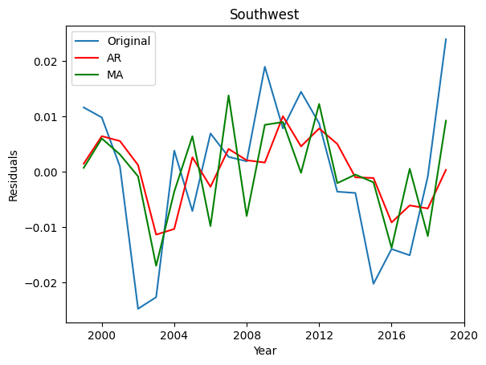
Plotted residuals, autoregressive predictions, and moving average predictions across geographic regions with highest rates of heart disease.

Slide 21
Key Takeaways

Slide 22

Conclusions
Polynomial Regression had the best fit (R² ≈ 0.99) across the groups of interest (Sex, Minority Races, Geographic Areas with highest rates of heart disease)
Overall trend in data easy to predict with this model
Goal: Observe how variation would deviate in the future → Hard to do
Calculate residuals → tried Autoregressive v. Moving Average
Similar fits (similar Log Likelihoods) → still not the best predictor

Slide 23
Thank you!
Questions?

Slide 24
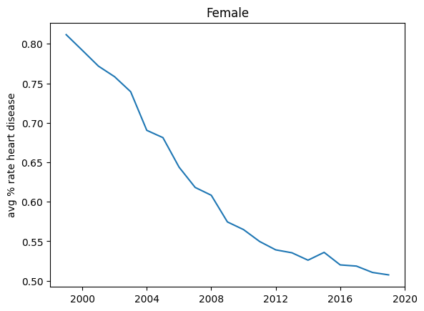
Polynomial Regression Continued
The graph to the right represents the trend in heart disease rates over the female demographic for the 21 year period.
First we will assign x values to the years of data, and y values to the average % rate of heart disease values, for each year in the data
x = pd.to_datetime(avg_female_df['year'], format="%Y")
y = avg_female_df['avg_rate_disease']
.

Slide 25
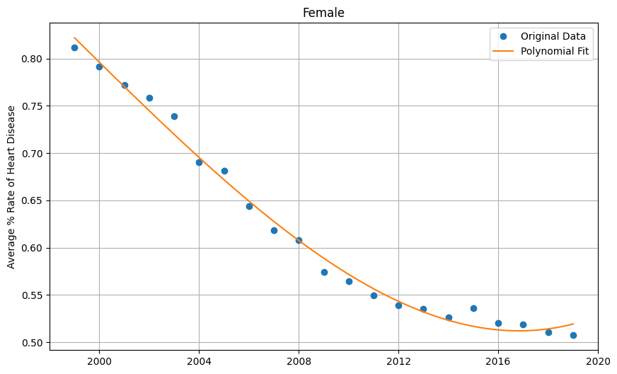
Polynomial Regression: Numpy Library
After assigning the x and y-values, we fit a polynomial function with a degree of 3 (cubic) to the data.
z = np.polyfit(x, y, 3)
f = np.poly1d(z)
The function returns coefficients of the polynomial that minimize the squared error (z).
z = np.polyfit(x, y, 3)
We then fit a polynomial function (f) using the coefficients(z), which is used to evaluate y-values for any given x-value.
f = np.poly1d(z)
Lastly, the new x and y-values are calculated using the polynomial function (f).
x_new = np.linspace(1999, 2019, 21)
y_new = f(x_new)

Slide 26
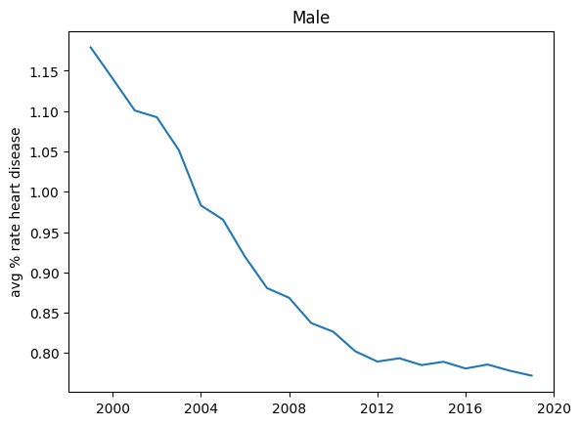
Polynomial Regression for the Male Demographic.

Slide 27
Minority Racial Groups

Slide 28
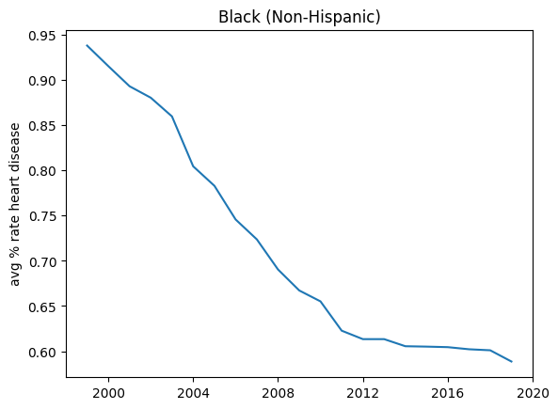
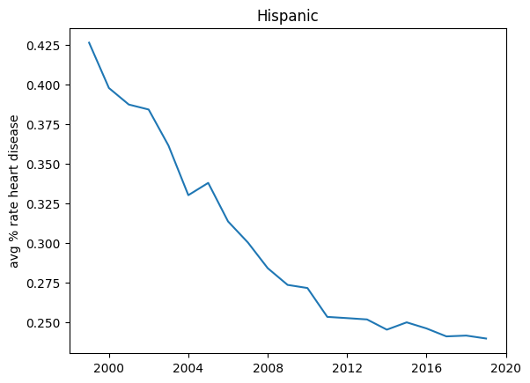
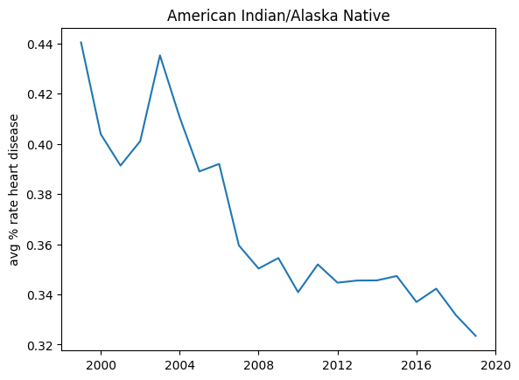
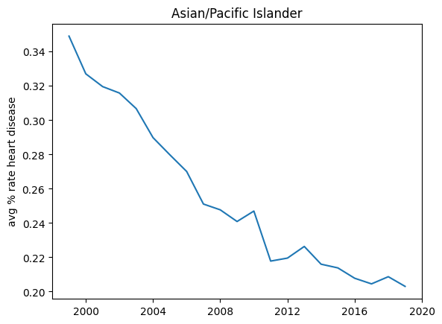
Polynomial Regression for Racial Minority Groups.

Slide 29
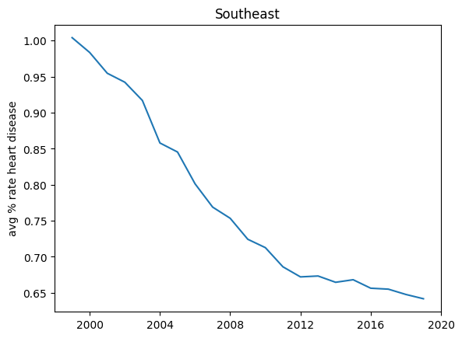
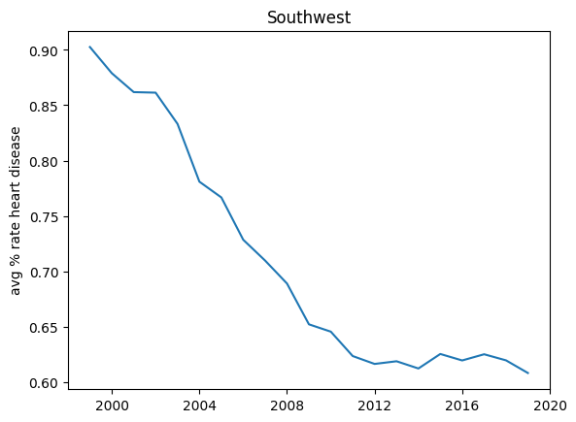
Polynomial Regression for Regions with HIghest Heart Disease Rates.

Slide 30
Preparing for Modeling: Residuals
Since our data has no seasonality, we will be using Time-Series modeling to predict the future values deviation from the trend(slow decrease.) We will create the residual data from the original data points, and the polynomial curve we fit to the data previously.

Slide 31
Residual Continued
We calculated the residual between the rate of heart disease predicted by the polynomial function and the actual rate.
avg_female_df['residual'] = y_new - avg_female_df['avg_rate_disease']
This was successful in creating ‘noise’ in the data.

Slide 32
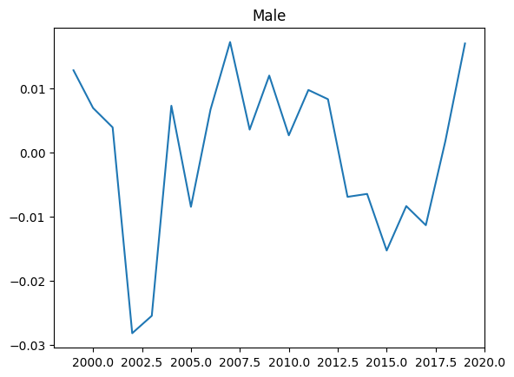
Residual for Male Demographic.

Slide 33
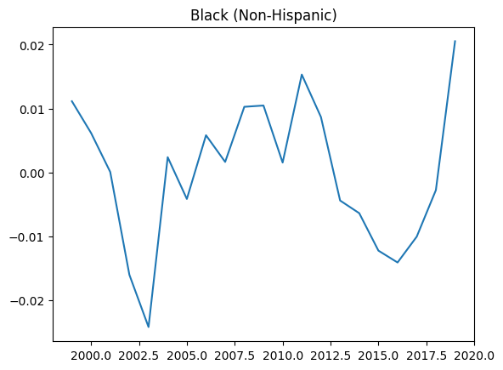
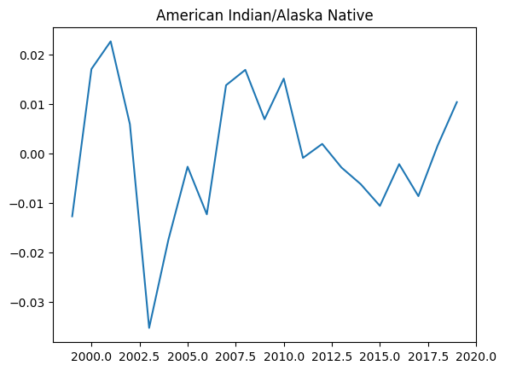
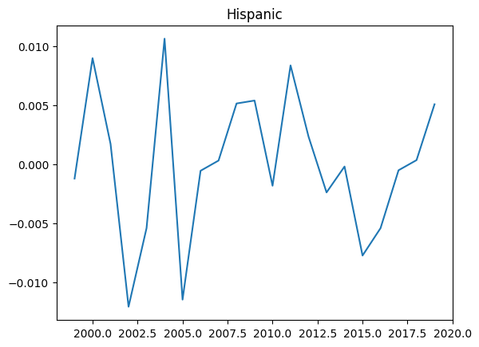
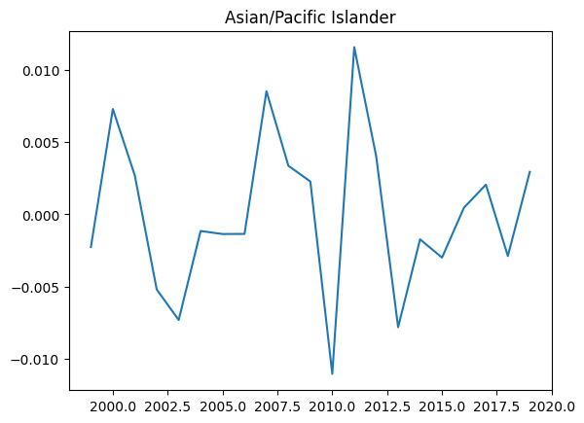
Residual for Racial Minority Groups.

Slide 34
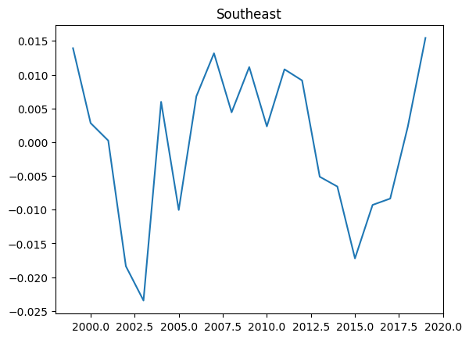
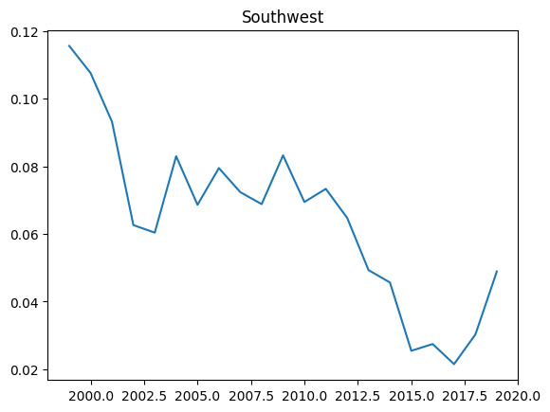
Residual for Regions with Highest Rates of Heart Disease.

